Slide 1



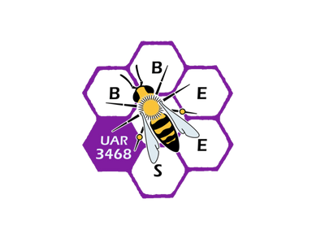

The Database and Data Integration (WP2)
Bruno Colas, Linda Angulo Lopez, Isabelle Baly
TRANSLOC Scientific Workshop, 10-12 September 2025

Slide 2
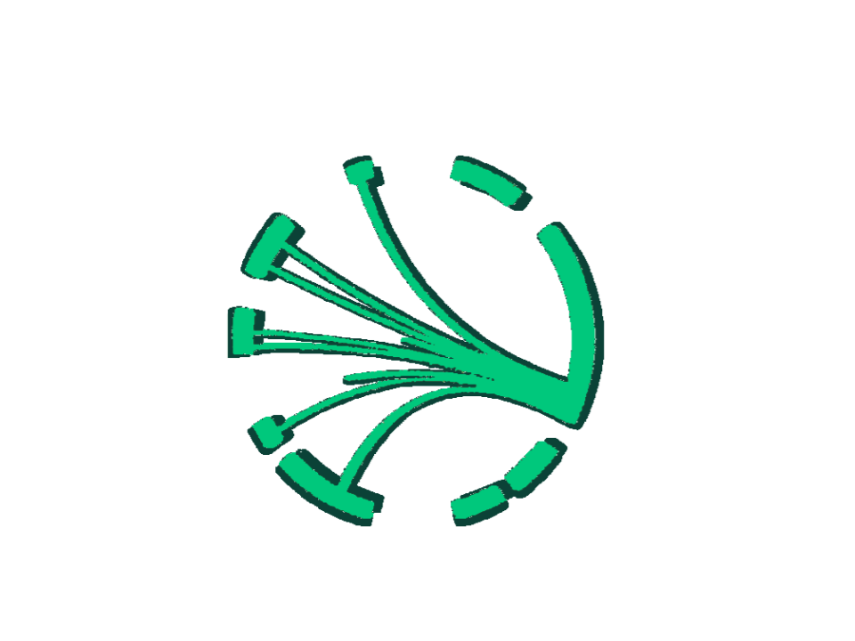
Enhancing Conservation Translocations through Data and Collaboration
Conservation translocations are increasingly used for biodiversity restoration and rewilding.
Success rates vary; ecological, evolutionary, and socio-conomic impacts remain underexplored.
TRANSLOC project (Biodiversa+): Evaluating translocations across multiple scales in the Western Palearctic.

Slide 3
What is the
TRANSLOC Database?
>1,300 documented conservation translocations
Diverse taxa: mammals, birds, plants, lichens, reptiles, amphibians, insects, molluscs
Standardized ecological, evolutionary, and socio-economic data
Open and accessible for researchers, practitioners, and policymakers

Slide 4
Other Key
Translocation Databases
IUCN Global Reintroduction Perspective – worldwide, multi-taxa
BirdLife International – avian-focused
National/Regional databases (UK, Spain, etc.)
Complementary scopes → opportunity for integration

Slide 5
WP2 Goals for Database Synergy
Harmonize TRANSLOC with other databases
Fill gaps & improve consistency
Enable cross-taxa and cross-region comparisons
Support ecological modeling & future scenarios
Foster collaboration among stakeholders

Slide 6
The Importance of
Integrated Translocation Data
Evidence-based conservation planning
Assess success & cost-effectiveness
Anticipate climate change & land-use challenges
Enhance social & economic impact evaluation
Contribute to restoration & rewilding

Slide 7
Scientific and
Societal Challenges
Stakeholder diversity: scientists, communities, policymakers
Pressures: climate change, invasive species, land use
Need for evidence-based frameworks
Balancing short-term conservation with long-term evolution

Slide 8
Multi-Disciplinary Approach
Integrating ecology, genetics, economics, and social sciences
Tools: field experiments, long-term monitoring, serious games, modeling
Stakeholder engagement: NGOs, farmers, local authorities, EU policy actors

Slide 9
Case Studies and Experimental Translocations
Freshwater mussels (France, Belgium)
Wetland plants (Spain, Switzerland)
Large mammals: Eurasian beaver, European bison
Raptors & carnivores: vultures, lynx reintroductions
Purpose: Refine success metrics, analyze socio-economic trade-offs

Slide 10
Outcomes & Expected Impacts
Scientific: biodiversity contribution, long-term viability
Policy: EU Biodiversity Strategy alignment, IUCN guidelines update
Societal: cost-benefit optimization, ethics, governance frameworks

Slide 11
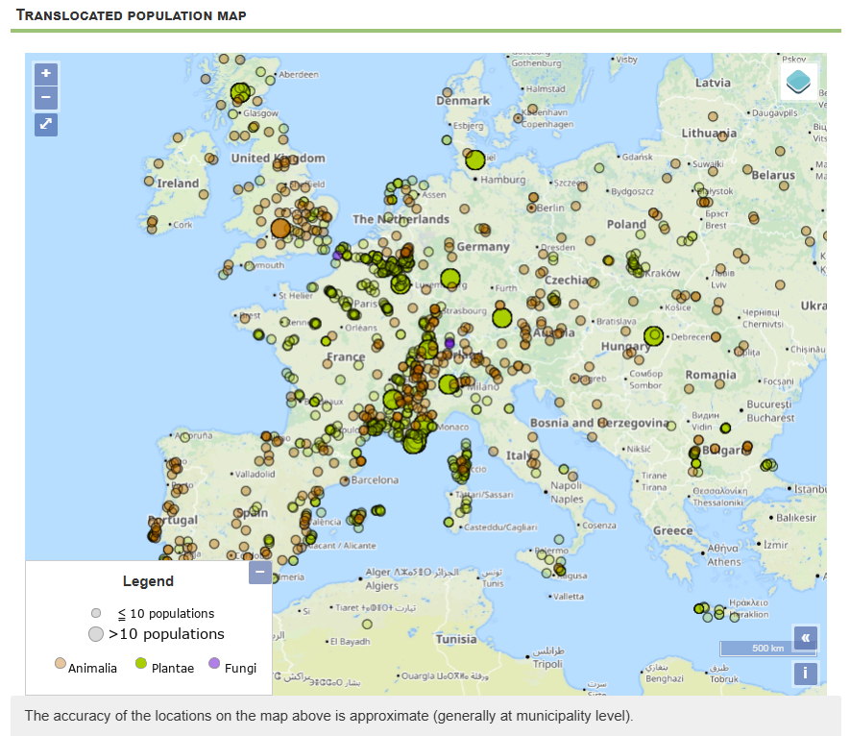
Exploring Data
Go to Home > Map
Select taxa, location, or years
Click 'Send query'
View results table + map

Slide 12
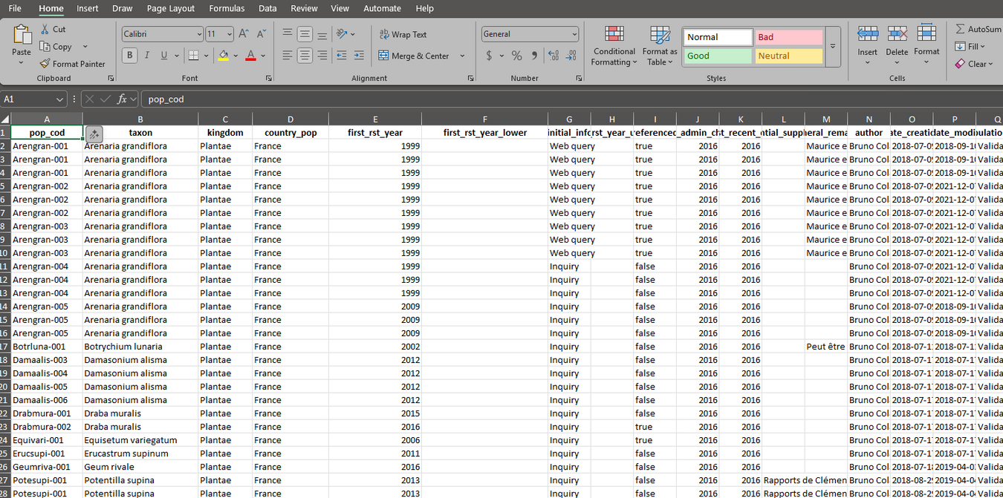
Viewing Detailed Data
(Logged In)
Go to Queries > Basic / Advanced
Select filters (species, population code, year, country, etc.)
Download table of results
Access detailed population/taxon pages

Slide 13
Contributing New Data
Step 1: Verify species name on GBIF
Step 2: Check if population already exists in DB
Step 3: If missing → create new taxon or population
Step 4: Fill mandatory fields (taxon, country, year of first translocation)
Step 5: Submit → admins validate (or bulk upload via Excel)

Slide 14
Updating Existing Data
Find your population (by code / query / map)
Open Data > Read/Complete > Populations
Add/modify fields → flagged until admin approval
Notifications sent to previous contributors

Slide 15
Next Steps and
Call for Collaboration
Expand coverage (taxonomic + geographic)
Incorporate citizen/practitioner data
Develop interactive dashboards and
user-friendly tools
Engage stakeholders to set priorities
Contribute to European and
global biodiversity targets

Slide 16
Contact & Further Information
François Sarrazin – francois.sarrazin@mnhn.fr
Website: http://translocations.in2p3.fr/
Funded by Biodiversa+ with EU and national support
Collaboration across European universities and & institutes

Slide 17













